Slide 1




Management of Prostate Cancer
Professor Janet E Brown
Professor Janet Brown

Slide 2
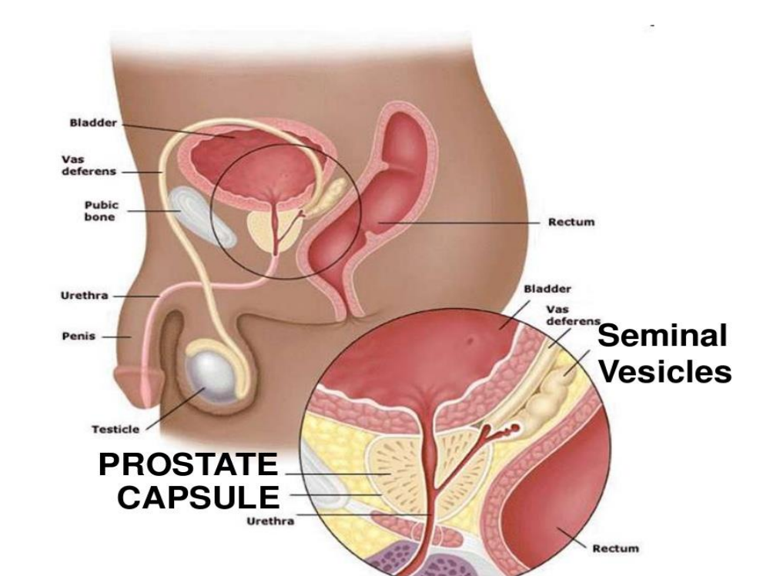
Functions of the prostate: The prostate is a male reproductive organ – its main function is to secrete prostate fluid one of the
components of semen. It also has a role in urination.

Slide 3
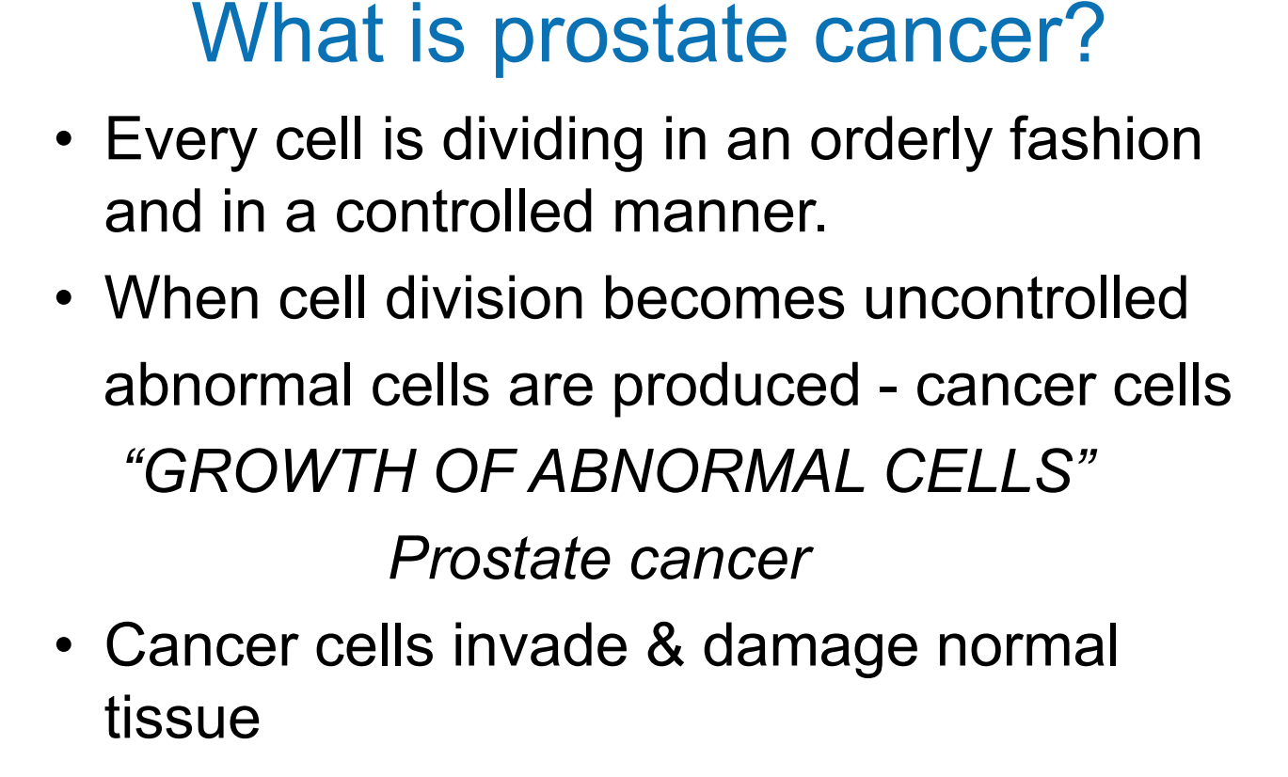

Slide 4
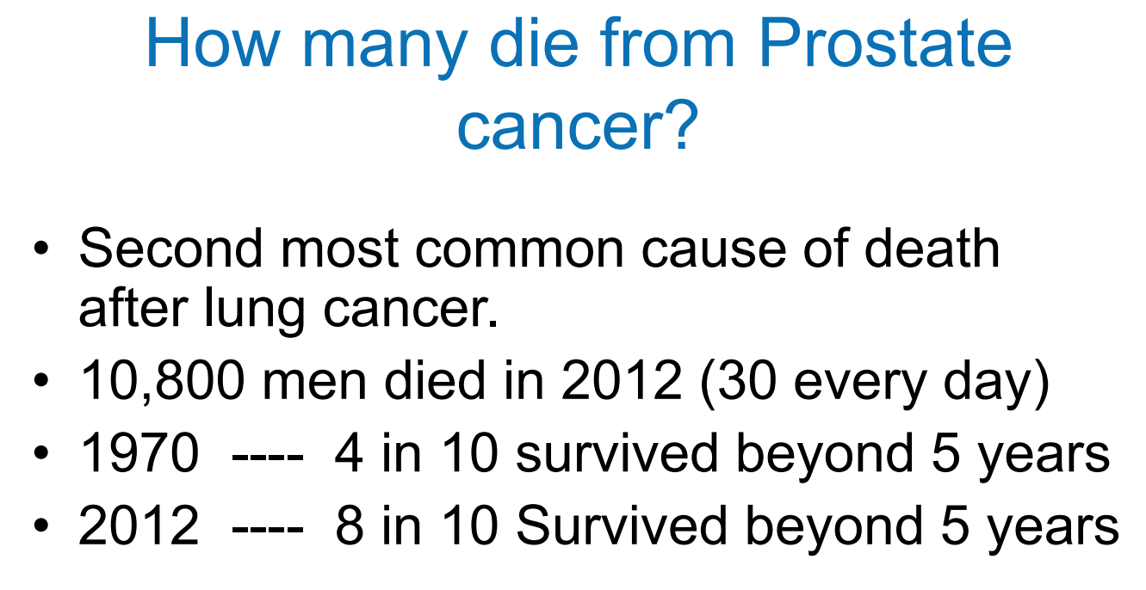

Slide 5
Prostate cancer:
Affects 1 in 8 men, 1 in 4 black men and incidence increases with age and strong
family history
Treatment options depend both on the size of the prostate cancer, its aggressiveness
and if it has already spread outside of the prostate capsule
Common areas of spread include lymph nodes, bone and other organs in
around a third of cases
Up to a third of men will receive treatment with Androgen Deprivation Therapy
(ADT), either alone or increasingly with other anti-androgens.

Slide 6
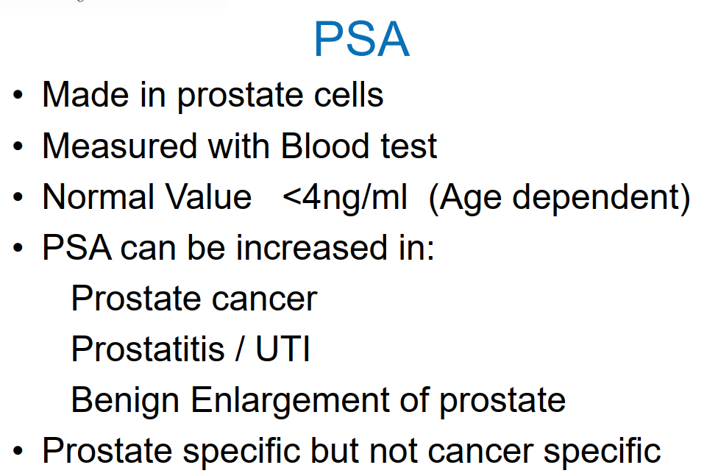

Slide 7
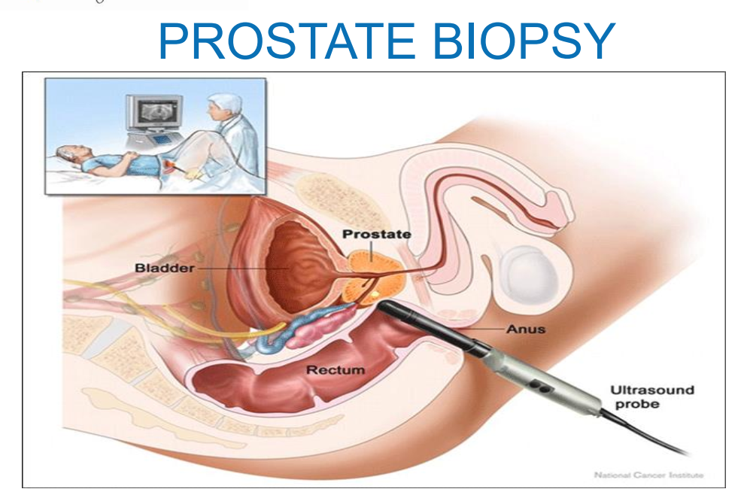
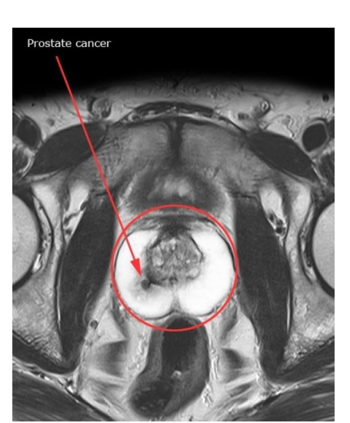
MRI

Slide 8
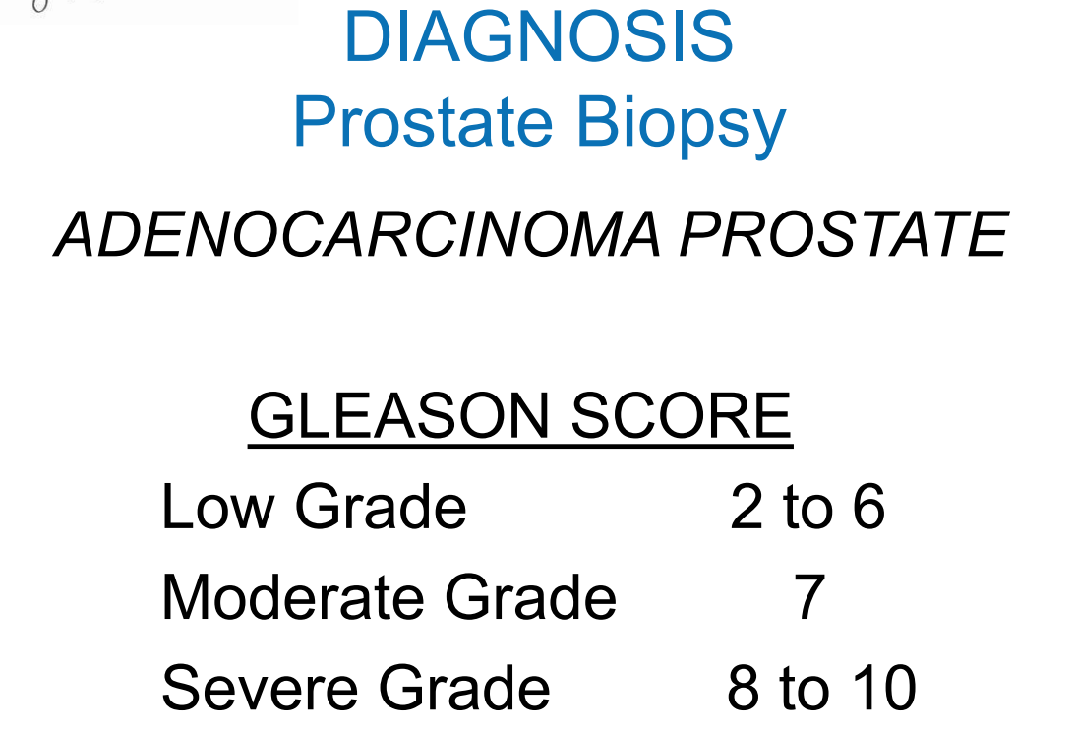

Slide 9
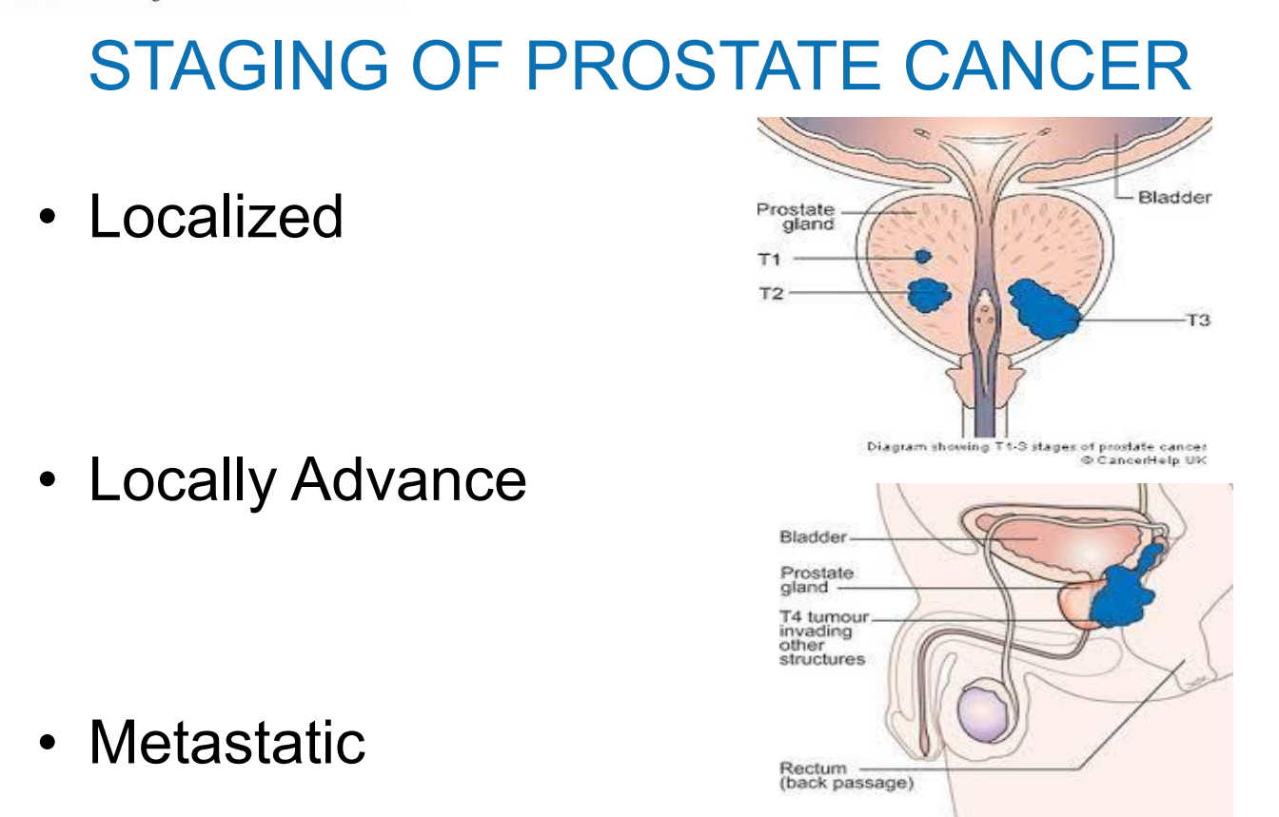

Slide 10
Treatment Options
Active Surveillance
Prostatectomy
Radiotherapy (external beam brachytherapy, stereotactic radiotherapy)
Hormone manipulation (ADT anti-androgens)
Chemotherapy
Radio-ligand therapy

Slide 11
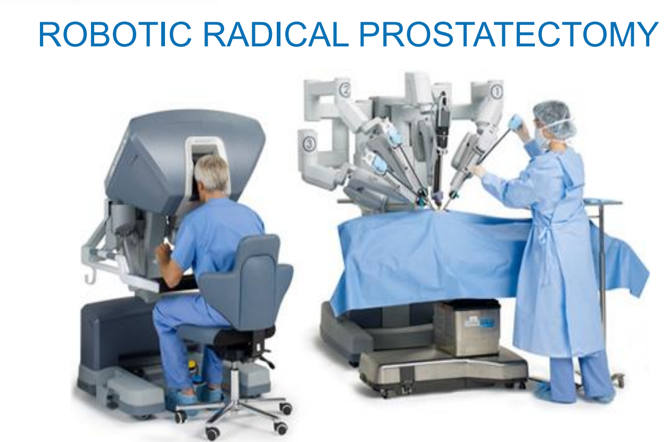

Slide 12
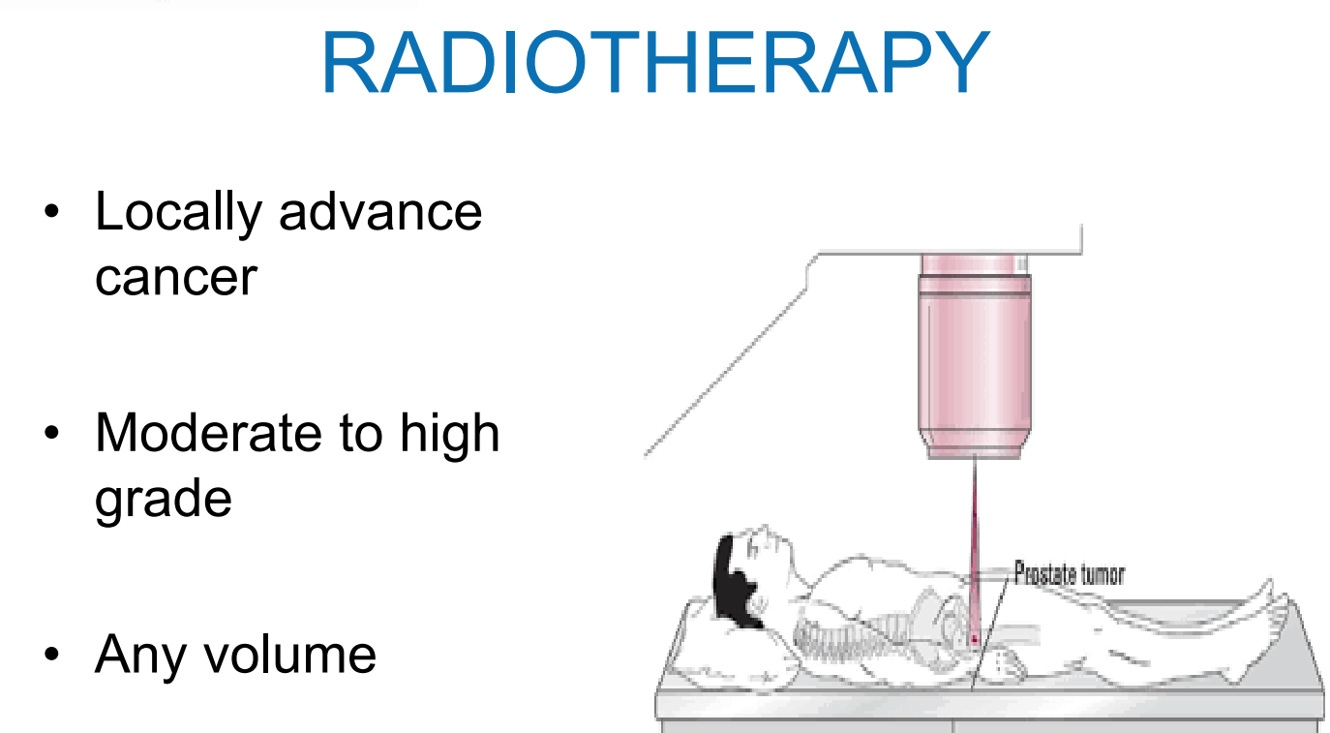

Slide 13
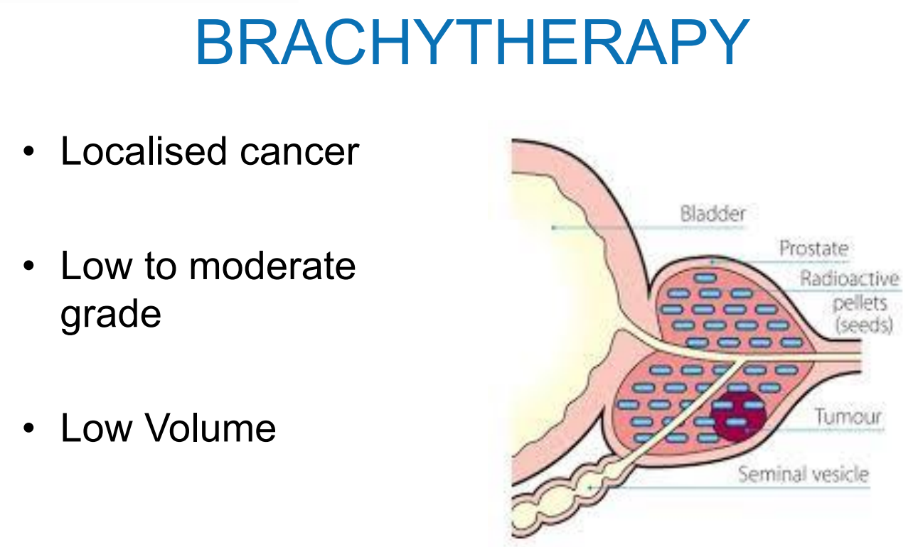

Slide 14
Effects of testosterone on prostate cancer growth:
First report that surgical castration and lowering of testosterone decreased
Prostate cancer growth was made in the 1850s
Mostly now testosterone suppression in prostate cancer patients is achieved
By chemical means, by drugs that inhibit testosterone

Slide 15
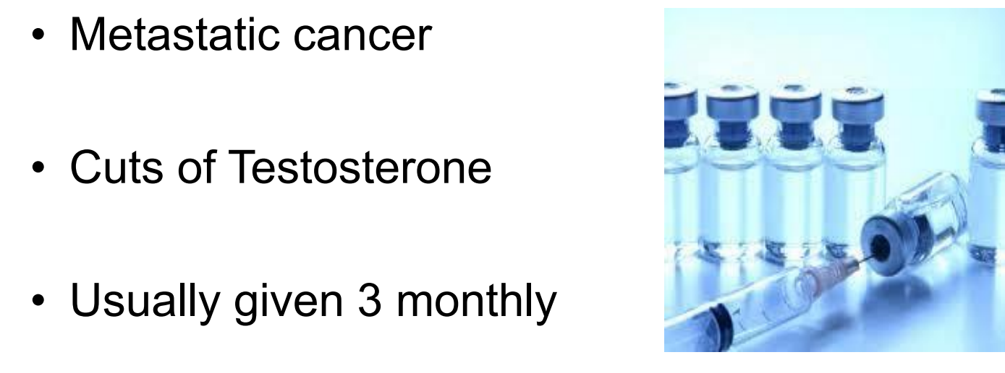
High grade localized prostate cancer
Biochemical release following prostatectomy or
radiotherapy.

Slide 16
Anti-androgens:
Until 10 years ago, once patients had developed rising PSA, it was felt that they had
become resistant to androgen-deprivation therapy. However, more recently,
anti-androgen drugs that target the AR-receptor (androgen receptor) have been
Discovered.
Such agents include abiraterone, enzalutamide, apalutamide - these are used in
patients with metastatic prostate cancer who have become resistant to ADT (or
increasingly in combination with ADT when patients start ADT) and improve survival.
Anti-androgens are normally given orally, often for years, and in some cases for
more than 5 years with ADT.

